Slide 1
MODULE 3: BIOSENSORS AND TELEMEDICINES
Biosensors: Various components of biosensors, Transducers in Biosensors: Various types of transducers; principles and applications, applications of biosensors.
Telemedicine: Block diagram of telemedicine system, origin and development of Telemedicine, Benefits, and limitations of Telemedicine.

Slide 2
Biosensors
Sensors: A sensor is a device that detects and responds to some type of input from the physical environment. The input can be light, heat, motion, moisture, pressure or any number of other environmental phenomena.
A sensor converts the physical action to be measured into an electrical equivalent and processes it so that the electrical signals can be easily sent and further processed.

Slide 3
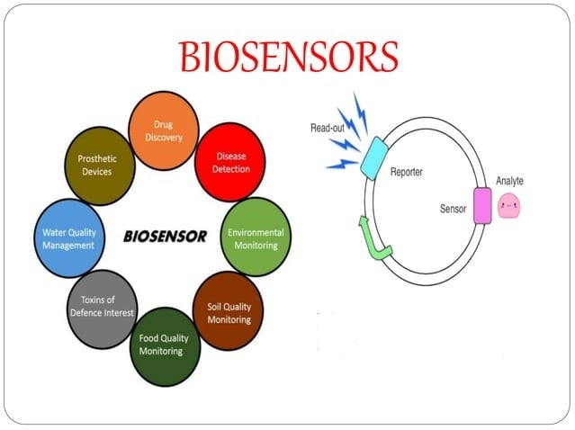

Slide 4
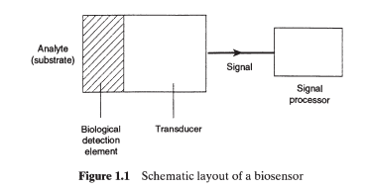
Biosensors: Continued…
In a biosensor, the sensing element which responds to the substance being measured is biological in nature.
It has to be connected to a transducer of some sort so that a visually observable response occurs.

Slide 5
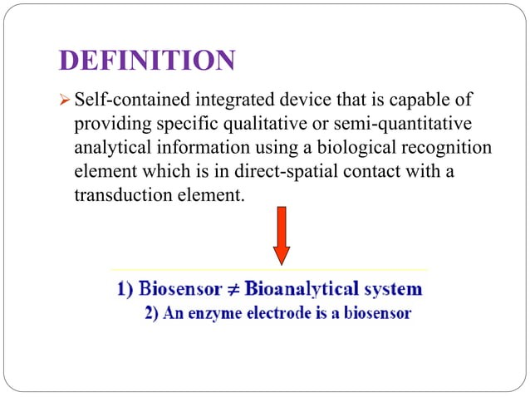

Slide 6
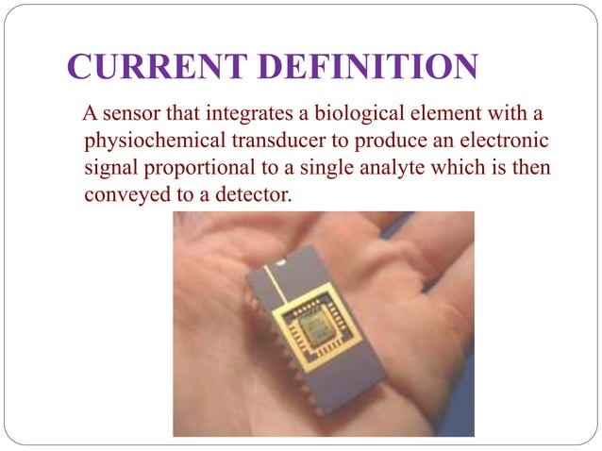

Slide 7
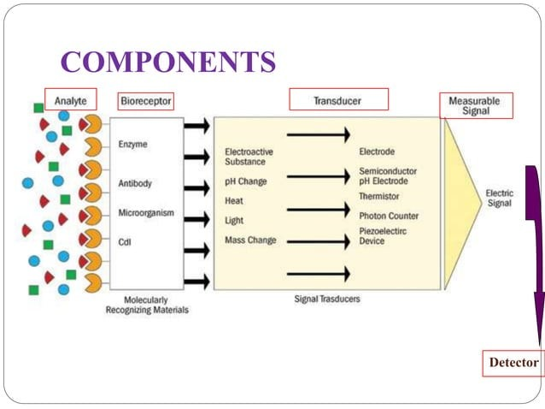

Slide 8
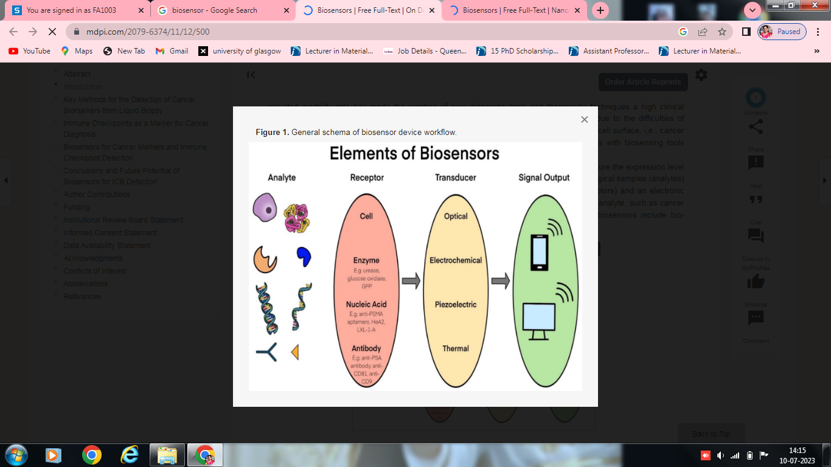

Slide 9
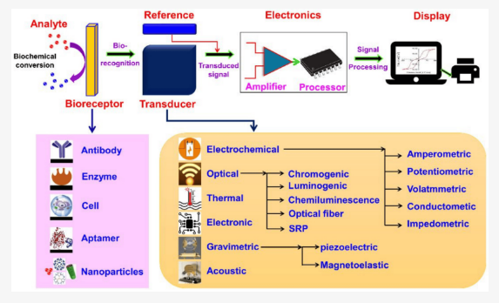

Slide 10
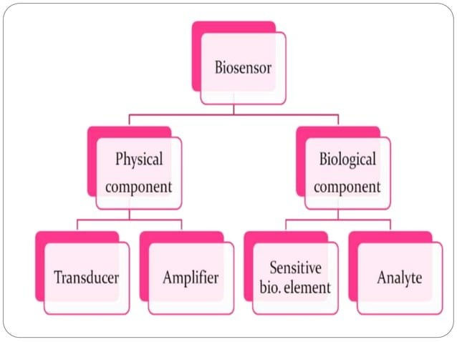
The important components of a biosensor are
(1) a bioreceptor (e.g., enzymes, antibody, microorganism, or cells); (2) a transducer of the physicochemical signal, and
(3) a signal processor to interpret the information that has been converted

Slide 11
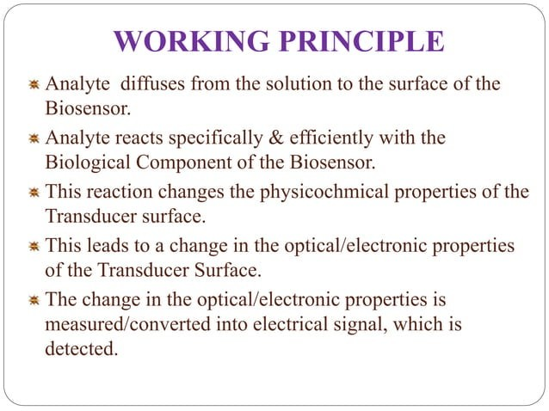

Slide 12
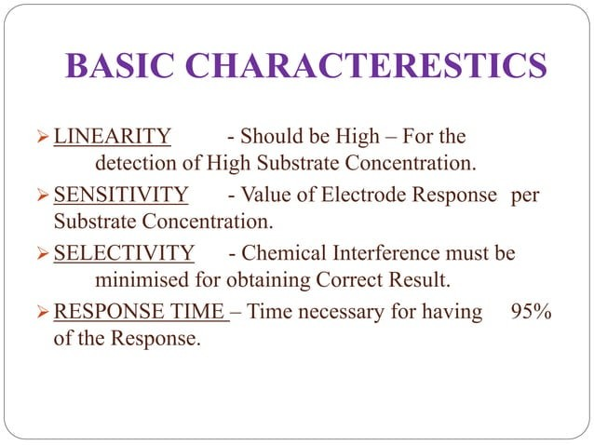

Slide 13
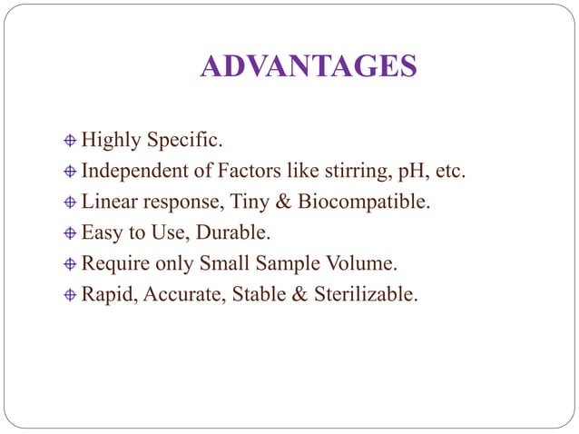

Slide 14
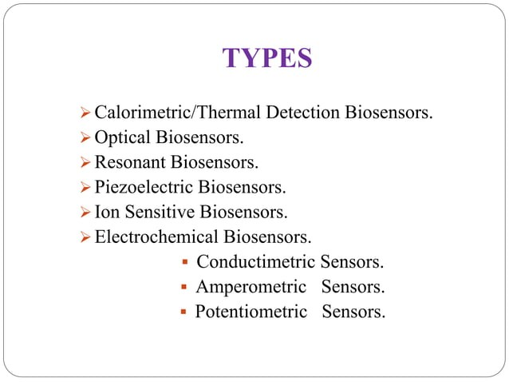

Slide 15
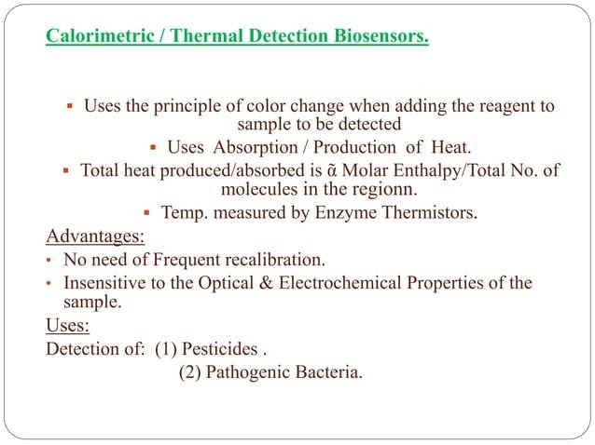

Slide 16
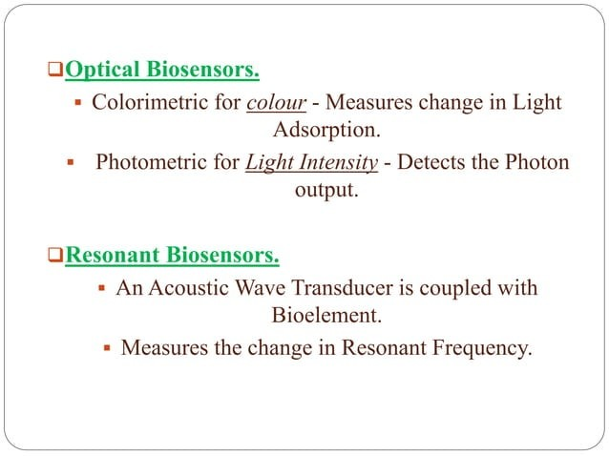

Slide 17
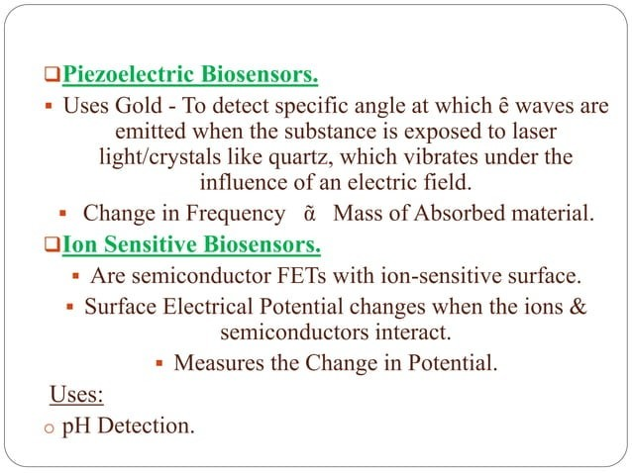

Slide 18
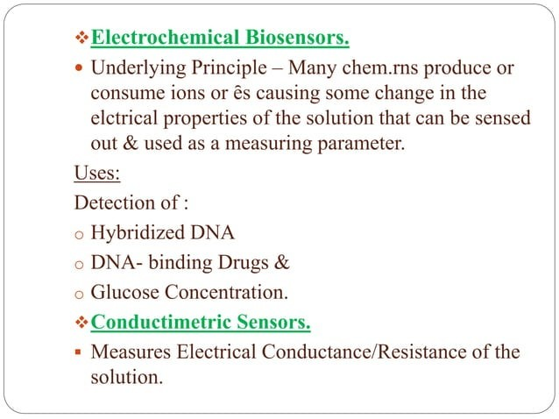

Slide 19
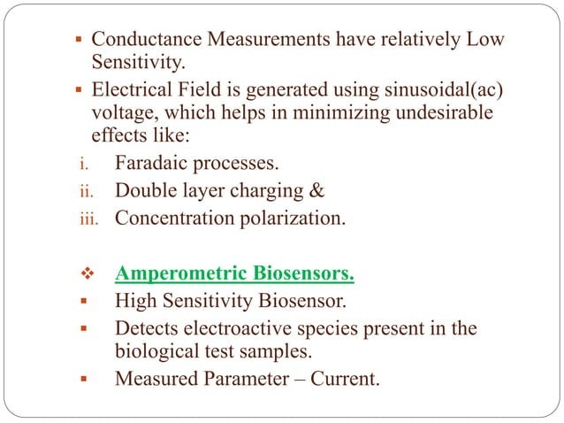

Slide 20
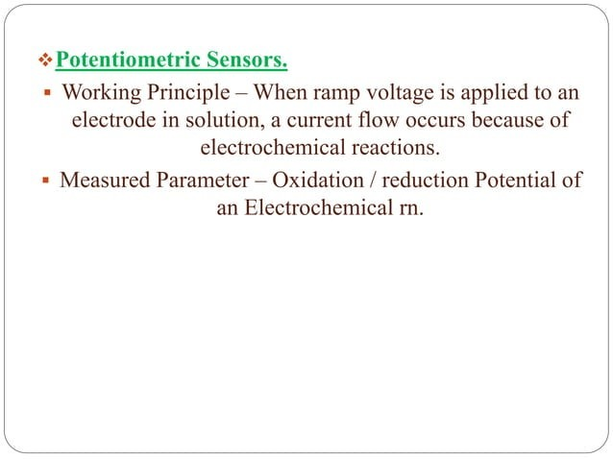

Slide 21
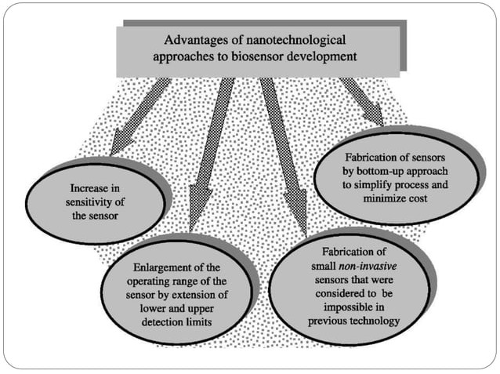

Slide 22
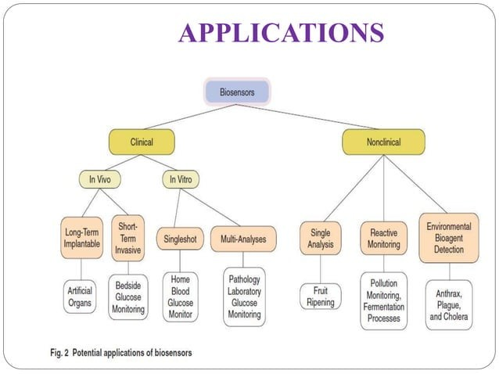

Slide 23
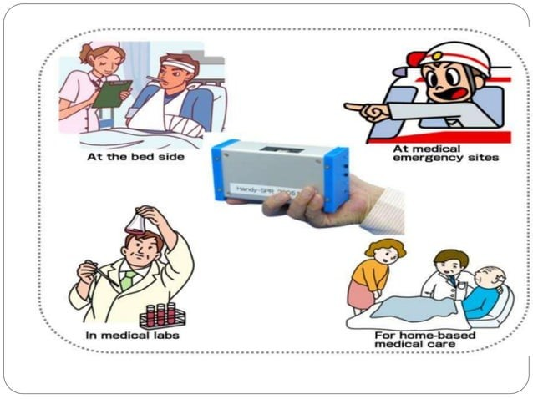

Slide 24
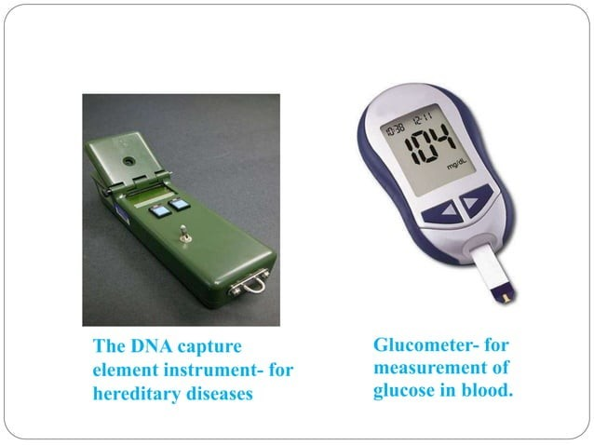

Slide 25
